Slide 1
The Simple Linear Regression Model:
Specification and Estimation
Part 1
BUAN / MECO 6312
Dr. Moran Blueshtein
University of Texas - Dallas

Slide 2
An Econometric Model
Starting point: Real-world expenditures and income are random variables, and we want to build an econometric model and use data to learn about the relationship between them.
Every econometric model starts with a theory:
For example: Economic theory tells us that expenditure on economic goods depends on income
Consequently expenditure is the ‘‘dependent variable’’ and income the independent’’ or ‘‘explanatory’’ variable.

Slide 3
An Econometric Model
To the economic model we will add the random error, to form the econometric model that is the basis for a quantitative or empirical economic analysis
This most common econometric model is the Linear Regression Model

Slide 4
An Econometric Model
The simple linear regression model is a linear model with only one explanatory variable:
where β₁ is the intercept and β₂ is the slope and e is an error term.
Eq. 2.1

Slide 5
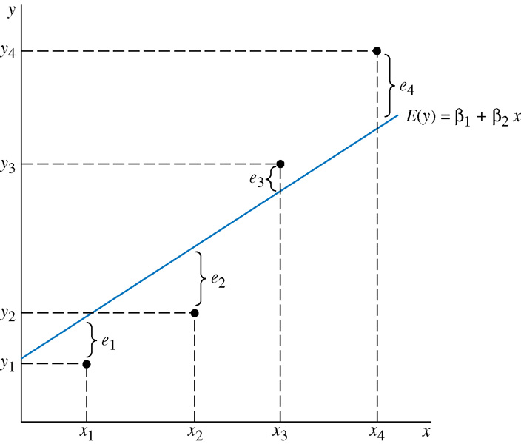
An Econometric Model
The relationship among y, e and the true regression line

Slide 6
An Econometric Model
There are several key assumptions underlying the simple linear regression

Slide 7
An Econometric Model
ASSUMPTIONS OF THE SIMPLE LINEAR REGRESSION MODEL
Assumption 1 (just for convenience):
The variable x is not random

Slide 8
An Econometric Model
ASSUMPTIONS OF THE SIMPLE LINEAR REGRESSION MODEL
Assumption 2:
The expected value of the random error e is:
This is equivalent to assuming that

Slide 9
An Econometric Model
ASSUMPTIONS OF THE SIMPLE LINEAR REGRESSION MODEL
Assumption 3:
The covariance between any pair of random errors, e_{i} and e_{j} is:
The stronger version of this assumption is that the random errors e are statistically independent, (so the values of the dependent variable y are also statistically independent).

Slide 10
An Econometric Model
ASSUMPTIONS OF THE SIMPLE LINEAR REGRESSION MODEL
Assumption 4:
The variance of the random error e is:
The random variables y and e have the same variance because they differ only by a constant.

Slide 11
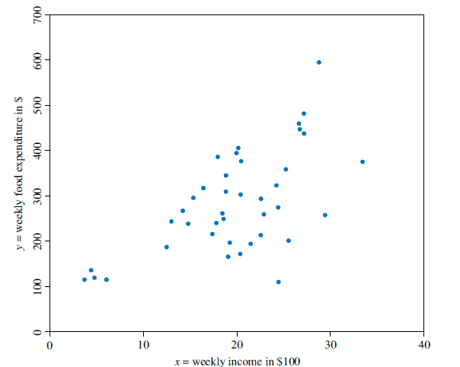
An Econometric Model
Data on food expenditure and income
Is this a good assumption for our food expenditure model?
and income
Data on food expenditure and income

Slide 12
An Econometric Model
ASSUMPTIONS OF THE SIMPLE LINEAR REGRESSION MODEL
Assumption 5:
(not crucial) The values of e are normally distributed around their mean
This also implies:

Slide 13
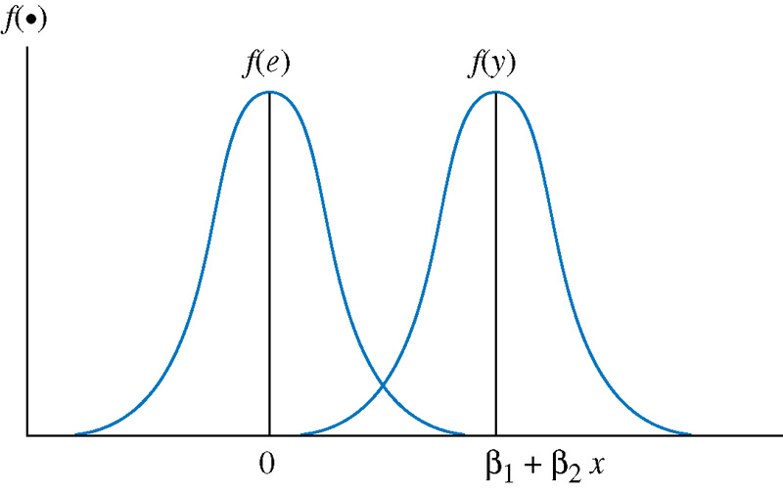
An Econometric Model
Probability density functions for e and y

Slide 14
The Simple Linear Regression Model:
Specification and Estimation
Part 2
BUAN / MECO 6312
Dr. Moran Blueshtein
University of Texas - Dallas

Slide 15
Estimating the Regression Parameters

Slide 16
An Econometric Model
The relationship among y, e and the true regression line

Slide 17
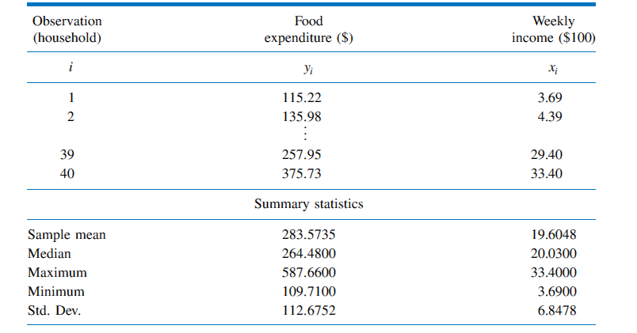
Estimating the Regression Parameters
Expenditure and Income Data

Slide 18
Estimating the Regression Parameters
Data on food expenditure and income

Slide 19
Estimating the Regression Parameters
The Least Squares Principle
The fitted regression line is:
The least squares residual is:

Slide 20
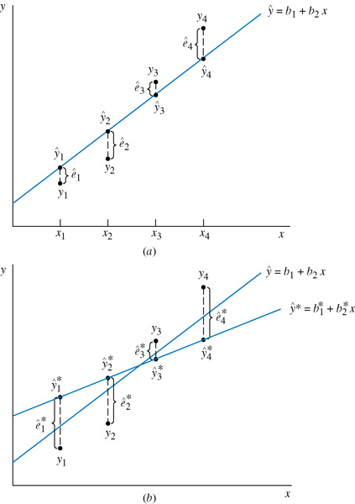
Estimating the Regression Parameters
The relationship among y, ê and the fitted regression line
The Least Squares Principle

Slide 21
Estimating the Regression Parameters
The Least Squares Principle
Least Squares estimators for the unknown parameters β₁ and β₂ are obtained my minimizing the sum of squared errors:

Slide 22
Estimating the Regression Parameters
The Least Squares Principle
Suppose we have another fitted line:
The least squares line has the smaller sum of squared residuals:

Slide 23
Derivation of the Least Squares Estimates
Set the derivatives equal to zero to get 2 eqs:

Slide 24
Estimating the Regression Parameters
THE LEAST SQUARES ESTIMATORS
The Least Squares Principle
We call b₁ and b₂ the least squares estimators (OLS).
What is the meaning of these formulas?

Slide 25
Estimating the Regression Parameters
Interpreting the Estimates
Given a specific sample we can now derive our least squares estimates
A convenient way to report the values for b₁ and b₂ is to write out the estimated or fitted regression line:

Slide 26
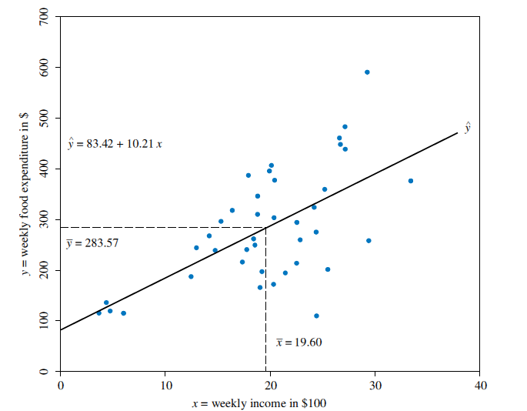
Estimating the Regression Parameters
The fitted regression line
Estimates for the Food Expenditure Function

Slide 27
Estimating the Regression Parameters
Interpreting the Estimates
The value b₂ = 10.21, thus, we estimate that if income goes up by $100, expected weekly expenditure on food will increase by approximately $10.21
the intercept estimate b₁ = 83.42 is an estimate of the weekly food expenditure on food for a household with zero income.

Slide 28
Estimating the Regression Parameters
Regression Output
Computer Output

Slide 29
Estimating the Regression Parameters
Prediction
Suppose that we wanted to predict weekly food expenditure for a household with a weekly income of $2000. This prediction is carried out by substituting x = 20 into our estimated equation to obtain:
We predict that a household with a weekly income of $2000 will spend on average $287.61 per week on food

Slide 30
Estimating the Regression Parameters
Elasticities
Income elasticity is a useful way to characterize the responsiveness of consumer expenditure to changes in income. The elasticity of a variable y with respect to another variable x is:

Slide 31
Estimating the Regression Parameters
Elasticities
We typically calculate the elasticity at the “point of the means” because it is a representative point on the regression line.
We estimate that a 1% increase in weekly household income will lead on average to a 0.71% increase in weekly household expenditure on food.

Slide 32
Assessing the Least Squares Fit
Part 1
BUAN/ MECO 6312
Dr. Moran Blueshtein
University of Texas - Dallas

Slide 33
Assessing the Least Squares Fit
THE LEAST SQUARES ESTIMATORS
Least Squares estimators are random variables!

Slide 34
Assessing the Least Squares Fit
How good are the Least Squares estimators?
What good properties are we looking for?
Unbiasedness -> E(b₂) = β₂
Minimal variance (efficiency)
Consistency
How do the Least Squares estimators compare to alternative estimators?

Slide 35
Assessing the Least Squares Fit
Unbiasedness
Unbiasedness
The property of unbiasedness means that if we took the averages of estimates from many samples, these averages would approach the true parameter.
Unbiasedness does not mean that an estimate from any one sample is close to the true parameter.

Slide 36
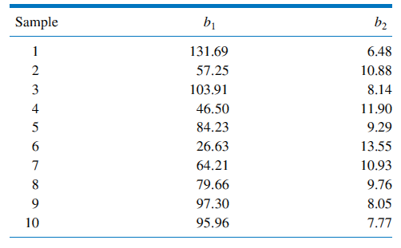
Assessing the Least Squares Fit
Estimates from 10 Samples
Repeated Sampling

Slide 37
Assessing the Least Squares Fit
Unbiasedness
Unbiasedness
If our model assumptions hold, then E(b₂) = β₂, which means that the OLS estimator is unbiased.
Let’s prove it!

Slide 38
Assessing the Least Squares Fit
The Estimator b₂
The estimator b₂
can be also written as:
Let’s denote
So:

Slide 39
Assessing the Least Squares Fit
The Estimator b₂

Slide 40
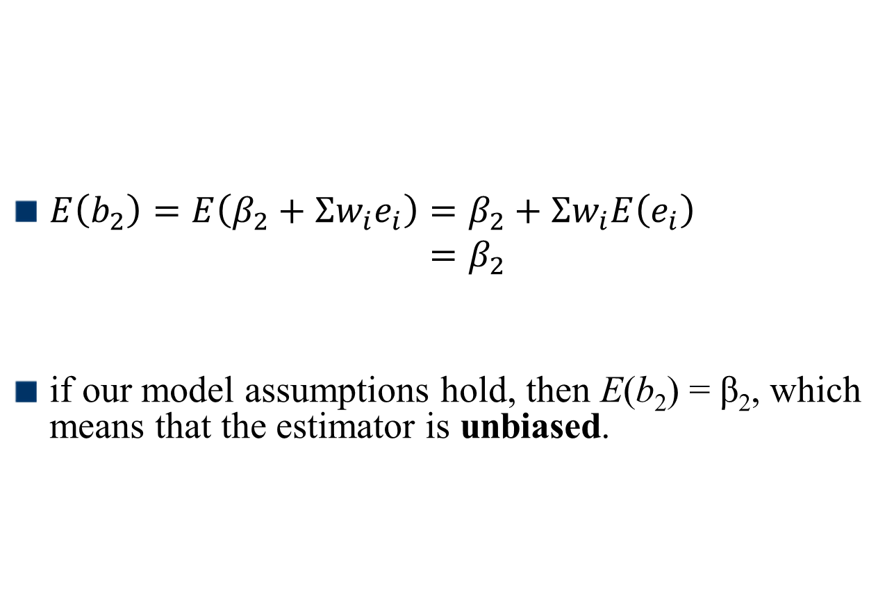
Assessing the Least Squares Fit
The Expected Values of b₂
$E\left(b_{2}\right)=E\left(β_{2}+Σw_{i}e_{i}\right)=β_{2}+Σw_{i}E\left(e_{i}\right)$ $=β_{2}$
if our model assumptions hold, then E(b₂) = β₂, which means that the estimator is unbiased.

Slide 41
Assessing the Least Squares Fit
Part 2
BUAN/ MECO 6312
Dr. Moran Blueshtein
University of Texas - Dallas

Slide 42
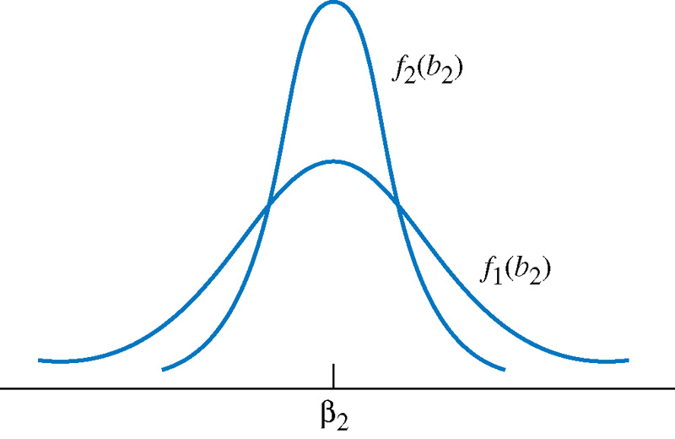
Assessing the Least Squares Fit
Variance
Variance
Estimator 2 is more efficient!

Slide 43
Assessing the Least Squares Fit
Efficiency
Efficiency
If you have two candidate estimators where one estimator has lower variance than the other, you will say that the estimator with the lower variance is more efficient.
When comparing between two candidates for unbiased estimators, we always want to use the one with the smaller variance, since that estimation rule gives us the higher probability of obtaining an estimate that is close to the true parameter value.

Slide 44
Assessing the Least Squares Fit
The Variance of b₂

Slide 45
Assessing the Least Squares Fit
The Variance of b₁
Similarly:

Slide 46
Assessing the Least Squares Fit
MAJOR POINTS ABOUT THE VARIANCE OF b₁ AND b₂
The Variances of b₁ and b₂
The larger the variance term σ² , the greater the uncertainty there is in the statistical model, and the larger the variances of the least squares estimators.
The larger , the smaller the variances of the least squares estimators and the more precisely we can estimate the unknown parameters.
The larger the term , the larger the variance of the least squares estimator b₁ (but note that not b₂ )
The larger the sample size N, the smaller the variances of the least squares estimators. The least squares estimator is thus also a consistent estimator

Slide 47
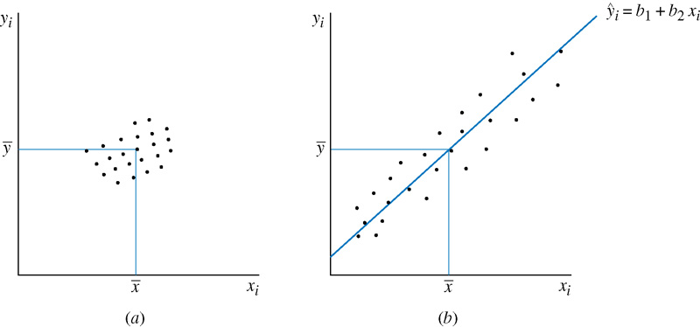
Assessing the Least Squares Fit
The Variances of b₁ and b₂

Slide 48
Assessing the Least Squares Fit
Consistency
Consistency
An estimator is consistent if, as the sample size increases, the estimates (produced by the estimator) "converge" to the true value of the parameter being estimated.
To be slightly more precise - consistency means that, as the sample size increases, the sampling distribution of the estimator becomes increasingly concentrated at the true parameter value.

Slide 49
Assessing the Least Squares Fit
Consistency
Variance of the estimator is decreasing with sample size

Slide 50
Assessing the Least Squares Fit
Consistency VS. Unbiasedness
Consistency Vs. unbiasedness
These two are not equivalent!
Unbiasedness is a statement about the expected value of the sampling distribution of the estimator.
Consistency is a statement about "where the sampling distribution of the estimator is going" as the sample size increases.

Slide 51
Assessing the Least Squares Fit
Consistency VS. Unbiasedness
Consistency Vs. unbiasedness
An Example
Consider a random variable X that is normally distributed N(μ,σ² ).
We can randomly draw from this population to create a sample x1,...,xn
Suppose you're estimating μ.
X1 is an unbiased estimator of μ
since E(X1)=μ
But the variance of X1 is always σ² so it is not consistent.
Similarly there are examples for estimators that are consistent but still biased.

Slide 52
Assessing the Least Squares Fit
Part 3
BUAN/ MECO 6312
Dr. Moran Blueshtein
University of Texas - Dallas

Slide 53
The Gauss-Markov Theorem

Slide 54
The Gauss-Markov Theorem
GAUSS-MARKOV THEOREM
Under the assumptions 2-4 of the linear regression model, the estimators b₁ and b₂ have the smallest variance of all linear and unbiased estimators of and . They are the Best Linear Unbiased Estimators (BLUE) of and

Slide 55
The Gauss-Markov Theorem
MAJOR POINTS ABOUT THE GAUSS-MARKOV THEOREM
Best?
Why Best?
The estimators b₁ and b₂ are best within their class because they have the minimum variance. In other words, among the class of linear and unbiased estimators, the least squares estimators are the most efficient ones.

Slide 56
The Gauss-Markov Theorem
MAJOR POINTS ABOUT THE GAUSS-MARKOV THEOREM
if we want to use a linear and unbiased estimator, then we have to do no more searching! The estimators b₁ and b₂ are the ones to use.
This explains why we are studying these estimators and why they are so widely used in research, not only in economics but in all social and physical sciences as well.

Slide 57
The Gauss-Markov Theorem
MAJOR POINTS ABOUT THE GAUSS-MARKOV THEOREM
The estimators b₁ and b₂ are “best” when compared to similar estimators, those which are linear and unbiased. The Theorem does not say that b₁ and b₂ are the best of all possible estimators.
In order for the Gauss-Markov Theorem to hold, assumptions 2-4 must hold. If any of these assumptions does not hold, then b₁ and b₂ are not the best linear unbiased estimators of β₁ and β₂.
Gauss-Markov Theorem does not depend on the assumption of normality (assumption 5) or the assumption of x’s being random variables (assumption 1)
The Gauss-Markov theorem applies to the least squares estimators. It does not apply to the least squares estimates from a single sample.

Slide 58
The Probability Distributions of the Least Squares Estimators
A CENTRAL LIMIT THEOREM
If assumptions 2-4 hold, and if the sample size N is sufficiently large, then the least squares estimators have a distribution that approximates the normal distributions.

Slide 59
The Probability Distributions of the Least Squares Estimators
We can make the normality assumption that the least squares estimators are normally distributed:

Slide 60
Estimating the Variance of the Least Squares (OLS ) Estimator

Slide 61
The Probability Distributions of the Least Squares Estimators
We can make the normality assumption that the least squares estimators are normally distributed:

Slide 62
Estimating the Variance of the Error Term
The variance of the random error e_{i} is:
The average is an intuitive average for the mean:
where :
This estimator turned out to be consistent but biased.

Slide 63
Estimating the Variance of the Error Term
There is a simple modification that produces a consistent and unbiased estimator, and that is:
so that:

Slide 64
Estimating the Variance of the Least Squares Estimators
Replace the unknown error variance σ² by :

Slide 65
Estimating the variance of the Least Squares Estimators
The square roots of the estimated variances are the “standard errors” of b₁ and b₂:

Slide 66
Standard Errors in the Regression Output
Computer Output

